Slide 1
Object-Oriented Systems Development:
Using the Unified Modeling Language
Chapter 4:
Object-Oriented Methodologies
Object-Oriented Systems Development Bahrami © Irwin/ McGraw-Hill

Slide 2

Goals
Object-Oriented Methodologies
  The Rumbaugh et al. OMT
  The Booch methodology
  Jacobson's methodologies
Object-Oriented Systems Development Bahrami © Irwin/ McGraw-Hill

Slide 3
Goals (Con’t)
Patterns
Frameworks
Unified Approach (UA)
layered Architecture
Object-Oriented Systems Development Bahrami © Irwin/ McGraw-Hill

Slide 4
Basic Definitions
A methodology is explained as the science of methods.
A method is a set of procedures in which a specific goal is approached step by step.
Object-Oriented Systems Development Bahrami © Irwin/ McGraw-Hill

Slide 5

Too Many Methodologies
1986: Booch came up with the object-oriented design concept, the Booch method.
1987: Sally Shlaer and Steve Mellor came up with the concept of the recursive design approach.
Object-Oriented Systems Development Bahrami © Irwin/ McGraw-Hill

Slide 6
Too Many Methodologies (Con’t)
1989: Beck and Cunningham came up with class-responsibility-collaboration (CRC) cards.
1990: Wirfs-Brock, Wilkerson, and Wiener came up with responsibility-driven design.
1991: Peter Coad and Ed Yourdon developed the Coad lightweight and prototype-oriented approach.
Object-Oriented Systems Development Bahrami © Irwin/ McGraw-Hill

Slide 7
Too Many Methodologies (Con’t)
1991: Jim Rumbaugh led a team at the research labs of General Electric to develop the object modeling technique (OMT).
1994: Ivar Jacobson introduced the concept of the use case.
Object-Oriented Systems Development Bahrami © Irwin/ McGraw-Hill

Slide 8
Survey of Some of the Object-Oriented Methodologies
Many methodologies are available to choose from for system development.
Here, we look at the methodologies developed by Rumbaugh et al., Booch, and Jacobson which are the origins of the Unified Modeling Language (UML) and the bases of the UA.
Object-Oriented Systems Development Bahrami © Irwin/ McGraw-Hill

Slide 9
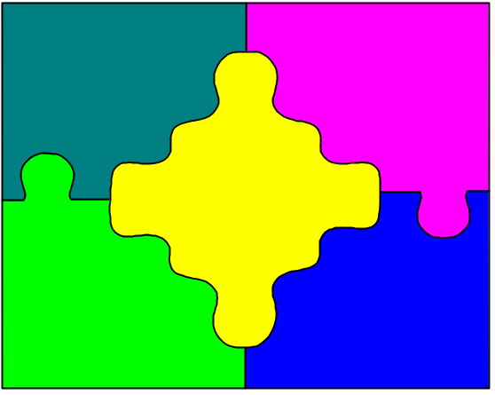
Rumbaugh et. al.’s Object Modeling Technique (OMT)
OMT describes a method for the analysis, design, and implementation of a system using an object-oriented technique.
Object-Oriented Systems Development Bahrami © Irwin/ McGraw-Hill

Slide 10
OMT (Con’t)
OMT consists of four phases, which can be performed iteratively:
  1. Analysis. The results are objects and dynamic and functional models.
  2. System design. The result is a structure of the basic architecture of the system.
Object-Oriented Systems Development Bahrami © Irwin/ McGraw-Hill

Slide 11
OMT (Con’t)
  3. Object design. This phase produces a design document, consisting of detailed objects and dynamic and functional models.
  4. Implementation. This activity produces reusable, extendible, and robust code.
Object-Oriented Systems Development Bahrami © Irwin/ McGraw-Hill

Slide 12
OMT Modeling
OMT separates modeling into three different parts:
  1. An object model, presented by the object model and the data dictionary.
  2. A dynamic model, presented by the state diagrams and event flow diagrams.
  3. A functional model, presented by data flow and constraints.
Object-Oriented Systems Development Bahrami © Irwin/ McGraw-Hill

Slide 13
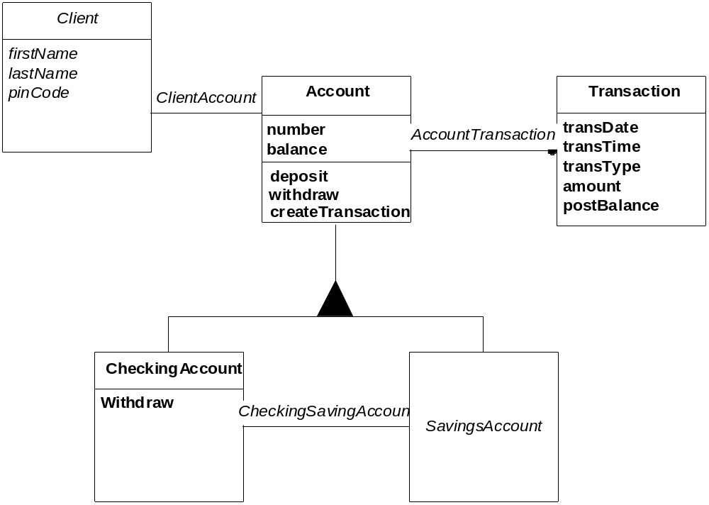
OMT Object Model
Object-Oriented Systems Development Bahrami © Irwin/ McGraw-Hill
Notes:
The OMT object model of a bank system. The boxes represents classes and filed triangle represent specialization. Association between Account and transaction is one to many, since one account can have many transactions, the filled circle represents many (zero or more). The relationship between Client and Account classes is one-to-one: A client can have only one account and account can belong to only one person (in this joint account are not allowed).

Slide 14
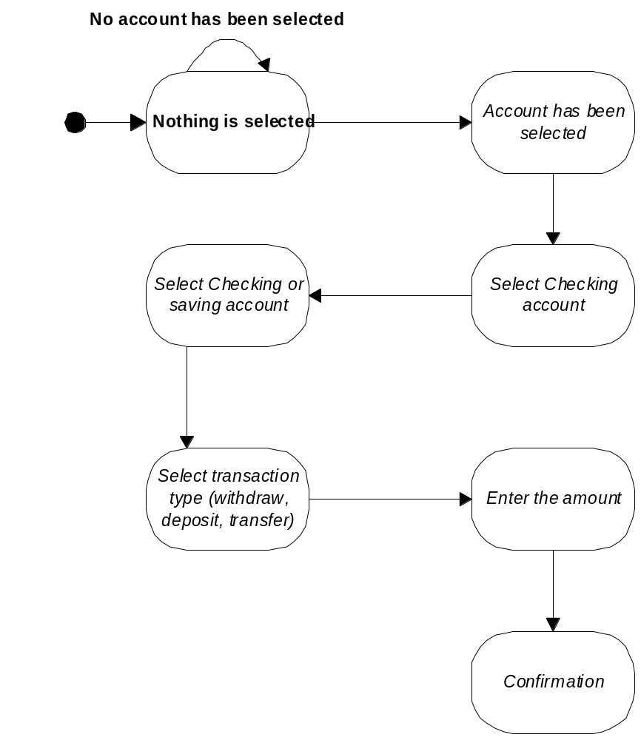
OMT Dynamic Model
Object-Oriented Systems Development Bahrami © Irwin/ McGraw-Hill
Notes:
State transition diagram for the bank application user interface. The round boxes represent states and the arrows represent transitions.

Slide 15
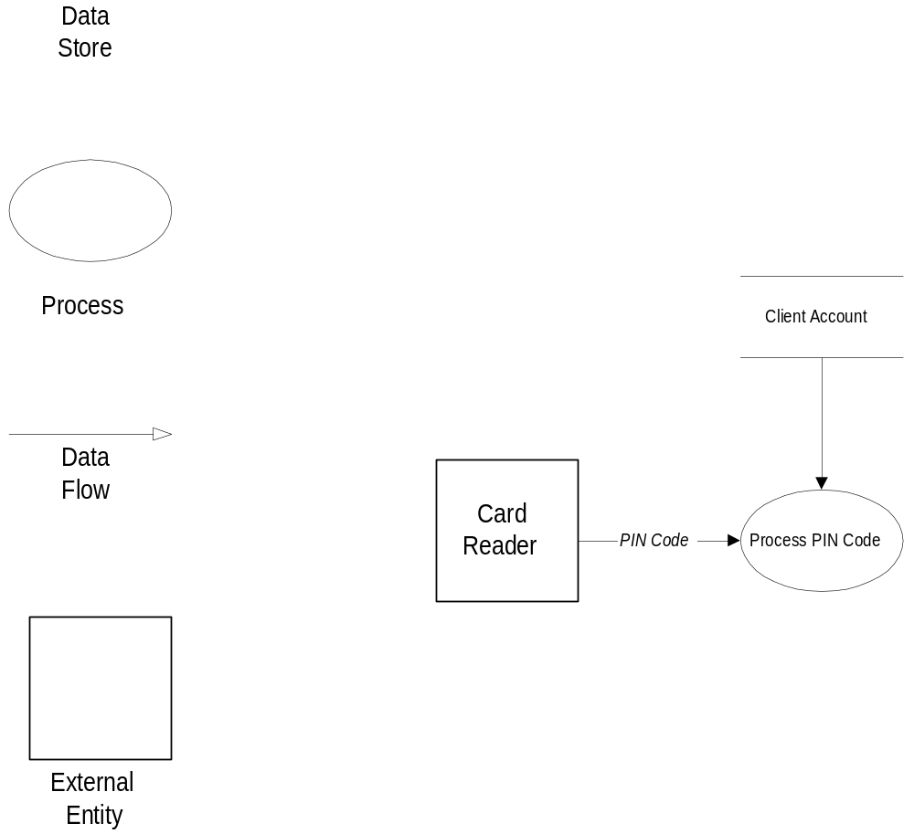
OMT Functional Model
Object-Oriented Systems Development Bahrami © Irwin/ McGraw-Hill
Notes:
OMT DFD of the ATM system. The data flow lines include arrows that show the direction of data element movement. The circle represents the process. The box represents external entity. A data store reveals the storage of data.

Slide 16

The Booch Methodology
The Booch methodology covers the analysis and design phases of systems development.
Booch sometimes is criticized for his large set of symbols.
Object-Oriented Systems Development Bahrami © Irwin/ McGraw-Hill

Slide 17
The Booch Methodology (Con’t)
The Booch method consists of the following diagrams:
  Class diagrams
  Object diagrams
  State transition diagrams
  Module diagrams
  Process diagrams
  Interaction diagrams
Object-Oriented Systems Development Bahrami © Irwin/ McGraw-Hill

Slide 18
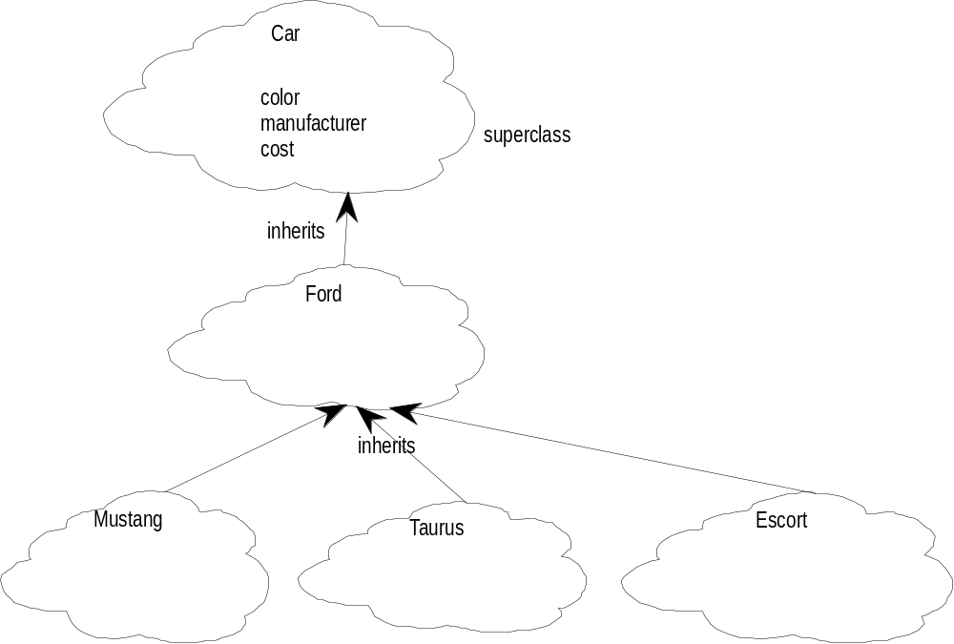
The Booch Methodology (Con’t)
Object-Oriented Systems Development Bahrami © Irwin/ McGraw-Hill
Notes:
Object modeling using Booch notation. The arrows represent specialization: for example, the class Taurus is subclass of the Class Ford.

Slide 19
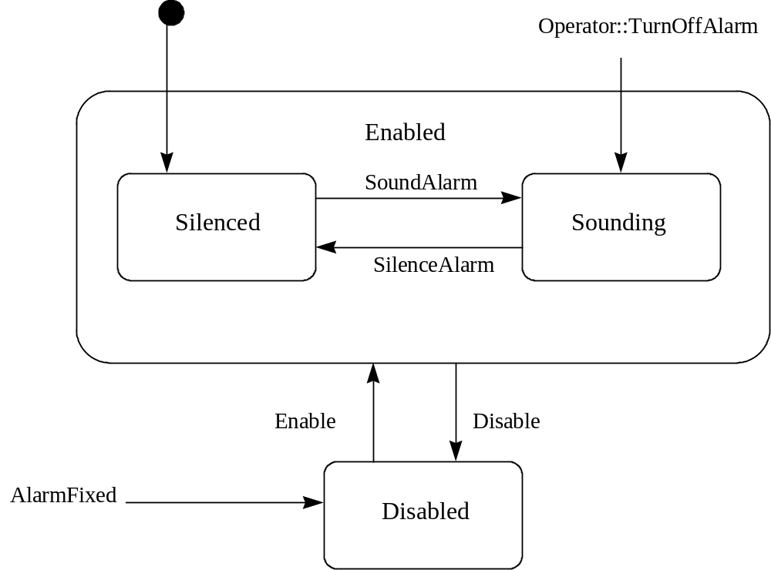
The Booch Methodology (Con’t)
Object-Oriented Systems Development Bahrami © Irwin/ McGraw-Hill
Notes:
An alarm class State Transition Diagram (STD) with Booch notation. This diagram can capture the state of a class based on a stimulus. For example, a stimulus causes the class to perform some processing, followed by a transition to another state. In this case, the alarm silenced state can be change to alarm sounding state and vice versa.

Slide 20
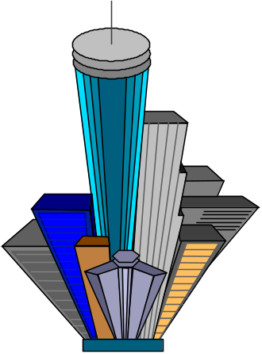

The Booch Methodology (Con’t)
The Booch methodology prescribes
  A macro development process
  A micro development process.
Object-Oriented Systems Development Bahrami © Irwin/ McGraw-Hill

Slide 21
The Macro Development Process
The macro development process consists of the following steps:
  1. Conceptualization
  2. Analysis and development of the model.
  3. Design or create the system architecture.
  4. Evolution or implementation.
  5. Maintenance.
Object-Oriented Systems Development Bahrami © Irwin/ McGraw-Hill
Notes:
The macro development process consists of the following steps:
1. Conceptualization. During conceptualization, you establish the core requirements of the system. You establish a set of goals and develop a prototype to prove the concept.
2. Analysis and development of the model. In this step, you use the class diagram to describe the roles and responsibilities objects are to carry out in performing the desired behavior of system. Then, you use the object diagram to describe the desired behavior of the system in terms of scenarios or, alternatively, use the interaction diagram to describe behavior of system in terms of scenarios.
3. Design or create the system architecture. In the design phase, you use the class diagram to decide what classes exist and how they relate to each other. Next, you use the object diagram to decide what mechanisms are used to regulate how objects collaborate. Then, you use the module diagram to map out where each class and object should be declared. Finally, you use the process diagram to determine to which processor to allocate a process. Also, determine the schedules for multiple processes on each relevant processor.
4. Evolution or implementation. Successively refine the system through many iterations. Produce a stream of software implementations (or executable releases), each of which is a refinement of the prior one.
5. Maintenance. Make localized changes to the system to add new requirements and eliminate bugs.

Slide 22
The Micro Development Process
The micro development process consists of the following steps:
  1. Identify classes and objects.
  2. Identify class and object semantics.
  3. Identify class and object relationships.
  4. Identify class and object interfaces and implementation.
Object-Oriented Systems Development Bahrami © Irwin/ McGraw-Hill

Slide 23

The Jacobson et al. Methodologies
The Jacobson et al. methodologies (e.g., OOBE, OOSE, and Objectory) cover the entire life cycle and stress traceability between the different phases.
Object-Oriented Systems Development Bahrami © Irwin/ McGraw-Hill

Slide 24

Use Cases
Use cases are scenarios for understanding system requirements.
A use case is an interaction between users and a system.
The use-case model captures the goal of the user and the responsibility of the system to its users.
Object-Oriented Systems Development Bahrami © Irwin/ McGraw-Hill

Slide 25
Use Cases (Con’t)
The use case description must contain:
  How and when the use case begins and ends.
  The interaction between the use case and its actors, including when the interaction occurs and what is exchanged.
Object-Oriented Systems Development Bahrami © Irwin/ McGraw-Hill

Slide 26

Use Cases (Con’t)
  How and when the use case will store data in the system.
  Exceptions to the flow of events.
Object-Oriented Systems Development Bahrami © Irwin/ McGraw-Hill

Slide 27
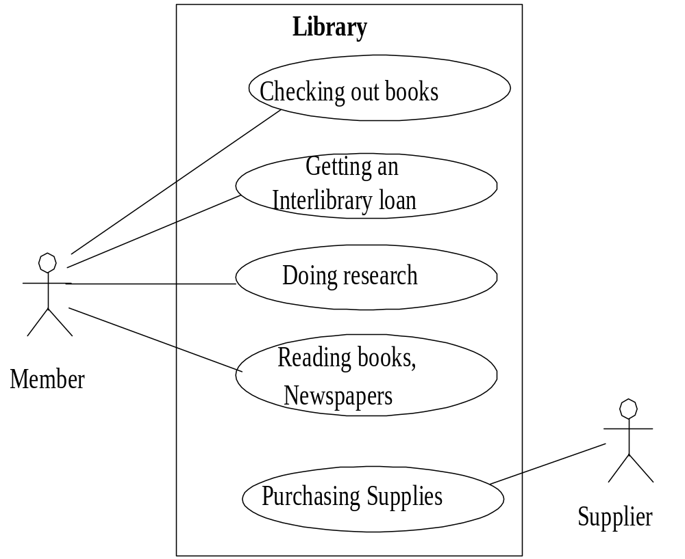
Object-Oriented Systems Development Bahrami © Irwin/ McGraw-Hill
Notes:
Some uses of a Library. As you can see these are uses of external views of the library system from an actor such as member of the library. The simpler the use-case the more effective it will be. It is unwise to capture all of the details right at the start, you can do that later.

Slide 28
Object-Oriented Software Engineering: Objectory
Object-oriented software engineering (OOSE), also called Objectory, is a method of object-oriented development with the specific aim to fit the development of large, real-time systems.
Object-Oriented Systems Development Bahrami © Irwin/ McGraw-Hill

Slide 29
Objectory (Con’t)
Objectory is built around several different models:
  Use case model.
  Domain object model.
  Analysis object model. Implementation model.
  Test model.
Object-Oriented Systems Development Bahrami © Irwin/ McGraw-Hill
Notes:
Use case model. The use case model defines the outside (actors) and inside (use case) of the system's behavior.
Domain object model. The objects of the "real" world are mapped into the domain object model.
Analysis object model. The analysis object model presents how the source code (implementation) should be carried out and written.
Implementation model. The implementation model represents the implementation of the system.
Test model. The test model constitutes the test plans, specifications, and reports

Slide 30
Object-Oriented Business Engineering (OOBE)
Object-oriented business engineering (OOBE) is object modeling at the enterprise level.
Use cases again are the central vehicle for modeling, providing traceability throughout the software engineering processes.
Object-Oriented Systems Development Bahrami © Irwin/ McGraw-Hill

Slide 31
Use-case model
Realized by
Tested in
Express in
Structured by
Implemented by
OK
NOT OK
Domain Object
Analysis
Design model
Implementation
Testing model
model
model
model
Object-Oriented Systems Development Bahrami © Irwin/ McGraw-Hill

Slide 32
OOBE (Con’t)
OOBE consists of :
  Analysis phase
  Design
  Implementation phases and
  Testing phase.
Object-Oriented Systems Development Bahrami © Irwin/ McGraw-Hill
Notes:
Analysis phase The analysis process should not take into account the actual implementation environment. This reduces complexity and promotes maintainability over the life the system, since the description of the system will be independent of hardware and software requirements.
Design and implementation phases. The implementation environment must be identified for the design model. This includes factors such as DBMS, distribution of process, constraints due to the programming language, available component libraries, and incorporation of graphical user interface tools. It may be possible to identify the implementation environment concurrently with analysis. The analysis objects are translated into design objects that fit the current implementation environment.
Testing phase. Jacobson describes several testing levels and techniques. The levels include unit testing, integration testing, and system testing.

Slide 33
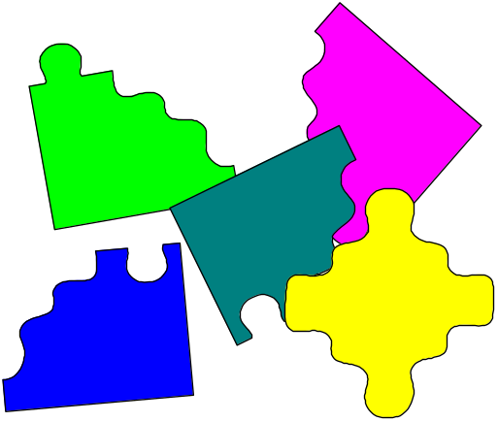
Patterns
A pattern is an instructive information that captures the essential structure and insight of a successful family of proven solutions to a recurring problem that arises within a certain context and system of forces.
Object-Oriented Systems Development Bahrami © Irwin/ McGraw-Hill

Slide 34
Patterns (Con’t)
The main idea behind using patterns is to provide documentation to help categorize and communicate about solutions to recurring problems.
The pattern has a name to facilitate discussion and the information it represents.
Object-Oriented Systems Development Bahrami © Irwin/ McGraw-Hill

Slide 35
Patterns (Con’t)
A good pattern will do the following:
It solves a problem. Patterns capture solutions, not just abstract principles or strategies.
It is a proven concept. Patterns capture solutions with a track record, not theories or speculation.
Object-Oriented Systems Development Bahrami © Irwin/ McGraw-Hill

Slide 36
Patterns (Con’t)
The solution is not obvious. The best patterns generate a solution to a problem indirectly—a necessary approach for the most difficult problems of design.
It describes a relationship. Patterns do not just describe modules, but describe deeper system structures and mechanisms.
Object-Oriented Systems Development Bahrami © Irwin/ McGraw-Hill

Slide 37

Patterns (Con’t)
The pattern has a significant human component.
All software serves human comfort or quality of life; the best patterns explicitly appeal to aesthetics and utility.
Object-Oriented Systems Development Bahrami © Irwin/ McGraw-Hill

Slide 38

Capturing Patterns
Guidelines for capturing patterns:
  Focus on practicability.
  Aggressive disregard of originality.
  Nonanonymous review.
  Writers' workshops instead of presentations.
  Careful editing.
Object-Oriented Systems Development Bahrami © Irwin/ McGraw-Hill
Notes:
Focus on practicability. Patterns should describe proven solutions to recurring problems rather than the latest scientific results.
Aggressive disregard of originality. Pattern writers do not need to be the original inventor or discoverer of the solutions that they document.
Nonanonymous review. Pattern submissions are shepherded rather than reviewed. The shepherd contacts the pattern author(s) and discusses with him or her how the patterns might be clarified or improved on.
Writers' workshops instead of presentations. Rather than being presented by the individual authors, the patterns are discussed in writers' workshops, open forums where all attending seek to improve the patterns presented by discussing what they like about them and the areas in which they are lacking.
Careful editing. The pattern authors should have the opportunity to incorporate all the comments and insights during the shepherding and writer's workshops before presenting the patterns in their finished form.

Slide 39
Frameworks
A framework is a way of presenting a generic solution to a problem that can be applied to all levels in a development.
A single framework typically encompasses several design patterns and can be viewed as the implementation of a system of design patterns.
Object-Oriented Systems Development Bahrami © Irwin/ McGraw-Hill

Slide 40
Differences Between Design Patterns and Frameworks
Design patterns are more abstract than frameworks.
Design patterns are smaller architectural elements than frameworks.
Design patterns are less specialized than frameworks.
Object-Oriented Systems Development Bahrami © Irwin/ McGraw-Hill
Notes:
Design patterns are more abstract than frameworks. Frameworks can be embodied in code, but only examples of patterns can be embodied in code. A strength of frameworks is that they can be written down in programming languages and not only studied but executed and reused directly. In contrast, design patterns have to be implemented each time they are used. Design patterns also explain the intent, trade-offs, and consequences of a design.
Design patterns are smaller architectural elements than frameworks. A typical framework contains several design patterns but the reverse is never true.
Design patterns are less specialized than frameworks. Frameworks always have a particular application domain. In contrast, design patterns can be used in nearly any kind of application. While more specialized design patterns are certainly possible, even these would not dictate an application architecture.

Slide 41
The Unified Approach
The idea behind the UA is not to introduce yet another methodology.
The main motivation here is to combine the best practices, processes, methodologies, and guidelines along with UML notations and diagrams.
Object-Oriented Systems Development Bahrami © Irwin/ McGraw-Hill
Notes:
The approach promoted in this book is based on the best practices that have proven successful in system development and, more specifically, the work done by the Booch, Rumbaugh, and Jacobson in their attempt to unify their modeling efforts. This unified approach (UA) establishes a unifying and unitary framework around their works by utilizing the unified modeling language (UML) to describe, model, and document the software development process.

Slide 42
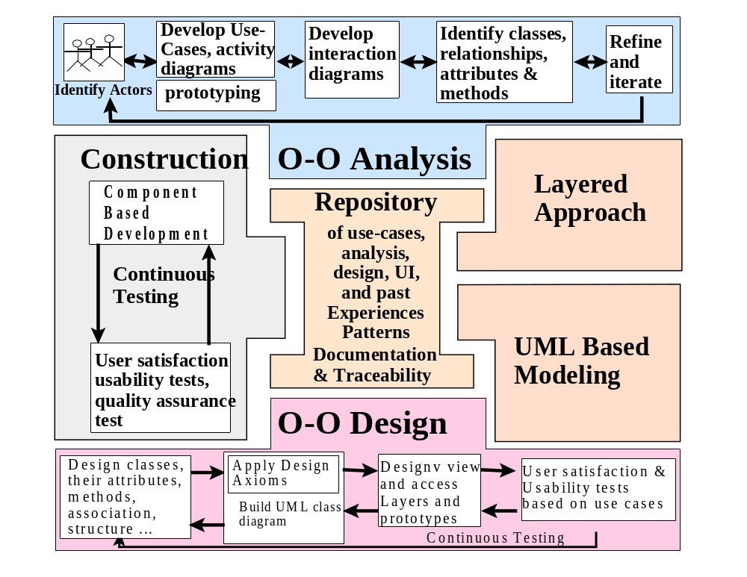
Object-Oriented Systems Development Bahrami © Irwin/ McGraw-Hill

Slide 43
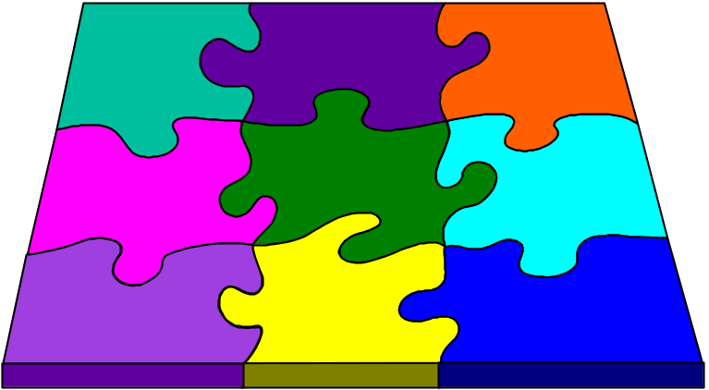
The Unified Approach (UA)
The unified approach to software development revolves around (but is not limited to) the following processes and components.
Object-Oriented Systems Development Bahrami © Irwin/ McGraw-Hill

Slide 44
UA Processes (Con’t)
The processes are:
  Use-case driven development.
  Object-oriented analysis.
  Object-oriented design.
  Incremental development and prototyping.
  Continuous testing.
Object-Oriented Systems Development Bahrami © Irwin/ McGraw-Hill

Slide 45
UA Methods and Technology
The methods and technology employed includes:
  Unified modeling language (UML) used for modeling.
  Layered approach.
  Repository for object-oriented system development patterns and frameworks.
  Promoting Component-based development.
Object-Oriented Systems Development Bahrami © Irwin/ McGraw-Hill

Slide 46
UA Object-Oriented Analysis: Use-Case Driven
The use-case model captures the user requirements.
The objects found during analysis lead us to model the classes.
The interaction between objects provide a map for the design phase to model the relationships and designing classes.
Object-Oriented Systems Development Bahrami © Irwin/ McGraw-Hill

Slide 47
UA Object-Oriented Design
Booch provides the most comprehensive object-oriented design method.
However, Booch methods can be somewhat imposing to learn and especially tricky to figure out where to start.
UA realizes this by combining Jacobson et al.'s analysis with Booch's design concept to create a comprehensive design process.
Object-Oriented Systems Development Bahrami © Irwin/ McGraw-Hill

Slide 48
Iterative Development and Continuous Testing
The UA encourages the integration of testing plans from day 1 of the project.
Usage scenarios or Use Cases can become test scenarios; therefore, use cases will drive the usability testing.
Object-Oriented Systems Development Bahrami © Irwin/ McGraw-Hill

Slide 49
Modeling Based on the Unified Modeling Language
The UA uses the unified modeling language (UML) to describe and model the analysis and design phases of system development.
Object-Oriented Systems Development Bahrami © Irwin/ McGraw-Hill
Notes:
The unified modeling language was developed by the joint efforts of the leading object technologists Grady Booch, Ivar Jacobson, and James Rumbaugh with contributions from many others.

Slide 50
The UA Proposed Repository
The requirement, analysis, design, and implementation documents should be stored in the repository, so reports can be run on them for traceability.
This allows us to produce designs that are traceable across requirements, analysis, design, implementation, and testing.
Object-Oriented Systems Development Bahrami © Irwin/ McGraw-Hill
Notes:
The main advantage is that all designs trace back directly to user requirements.

Slide 51
The Layered Approach to Software Development
Most systems developed with today's CASE tools or client-server application development environments tend to lean toward what is known as two-layered architecture: interface and data.
Object-Oriented Systems Development Bahrami © Irwin/ McGraw-Hill

Slide 52
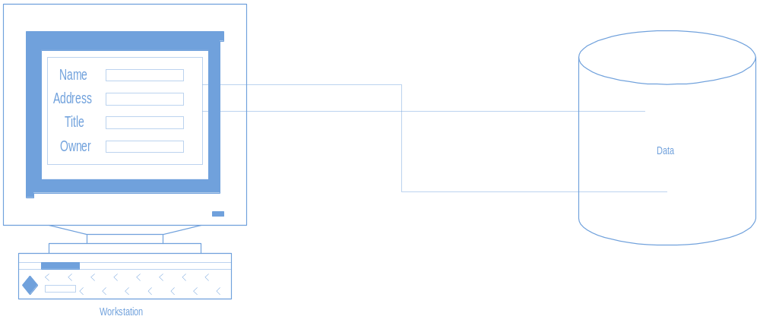
Two-Layer Architecture
In a two-layer system, user interface screens are tied directly to the data through routines that sit directly behind the screens.
Object-Oriented Systems Development Bahrami © Irwin/ McGraw-Hill

Slide 53
Problem With the Two-Layer Architecture
This approach results in objects that are very specialized and cannot be reused easily in other projects.
Object-Oriented Systems Development Bahrami © Irwin/ McGraw-Hill

Slide 54
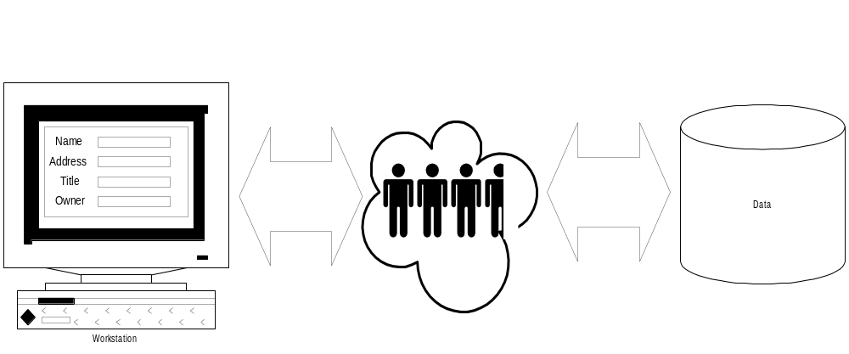
Three-Layer Architecture
Your objects are completely independent of how:
  they are represented to the user (through an interface) or
  how they are physically stored.
Object-Oriented Systems Development Bahrami © Irwin/ McGraw-Hill

Slide 55

User Interface layer
This layer is typically responsible for two major aspects of the applications:
Responding to user interaction
Displaying business objects.
Object-Oriented Systems Development Bahrami © Irwin/ McGraw-Hill

Slide 56
Business Layer
The responsibilities of the business layer are very straight- forward:
model the objects of the business and how they interact to accomplish the business processes.
Object-Oriented Systems Development Bahrami © Irwin/ McGraw-Hill

Slide 57
Business Layer: Real Objects (Con’t)
These objects should not be responsible for:
Displaying details
Data access details
Object-Oriented Systems Development Bahrami © Irwin/ McGraw-Hill

Slide 58
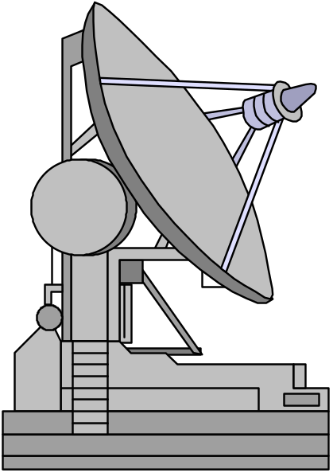
Access Layer
The access layer contains objects that know how to communicate with the place where the data actually resides,
Whether it be a relational database, mainframe, Internet, or file.
Object-Oriented Systems Development Bahrami © Irwin/ McGraw-Hill

Slide 59
Access Layer
The access layer has two major responsibilities:
Translate request
Translate result
Object-Oriented Systems Development Bahrami © Irwin/ McGraw-Hill

Slide 60
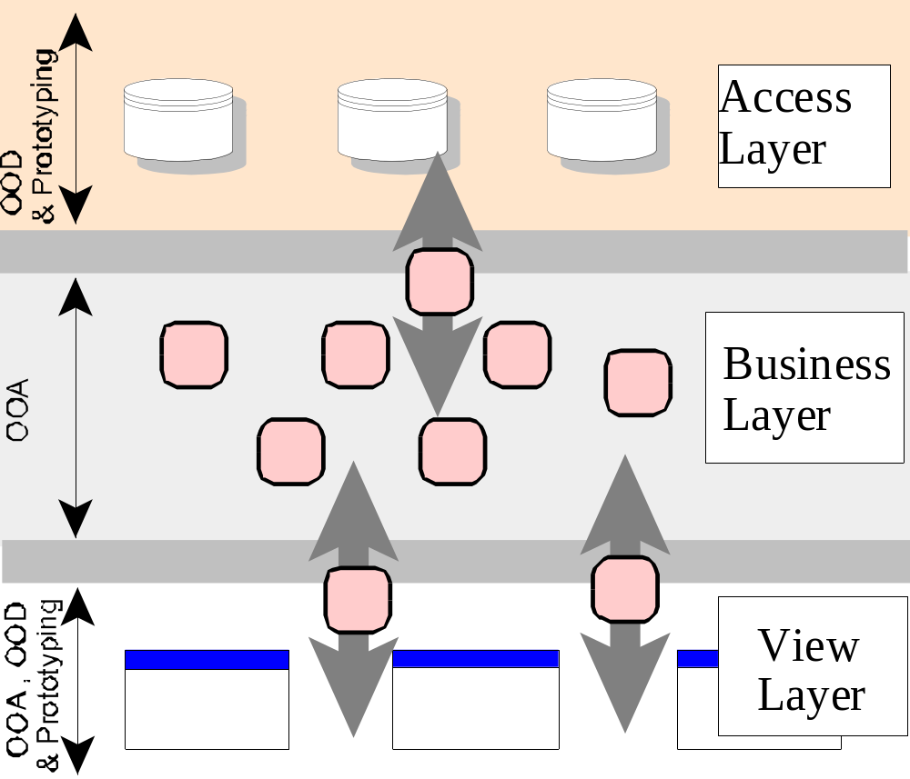
Three-Layered Architecture
Object-Oriented Systems Development Bahrami © Irwin/ McGraw-Hill

Slide 61

Summary
we looked at current trends in object-oriented methodologies, which have been toward combining the best aspects of today's most popular methods.
Object-Oriented Systems Development Bahrami © Irwin/ McGraw-Hill

Slide 62
Summary (Con’t)
Each method has its strengths. Rumbaugh et al. have a strong method for producing object models.
Jacobson et al. have a strong method for producing user-driven requirement and object-oriented analysis models.
Booch has a strong method for producing detailed object-oriented design models.
Object-Oriented Systems Development Bahrami © Irwin/ McGraw-Hill

Slide 63
Summary (Con’t)
Each method has weakness, too. While OMT has strong methods for modeling the problem domain, OMT models cannot fully express the requirements.
Jacobson, although covering a fairly wide range of the life cycle, does not treat object-oriented design to the same level as Booch, who focuses almost entirely on design, not analysis.
Object-Oriented Systems Development Bahrami © Irwin/ McGraw-Hill

Slide 64
Summary (Con’t)
The UA is an attempt to combine the best practices, processes, and guidelines along with UML notations and diagrams for better understanding of object-oriented concepts and object-oriented system development.
Object-Oriented Systems Development Bahrami © Irwin/ McGraw-Hill

